Slide 1











COMMUNITY
REINVESTMENT
ENGAGING YOUR COMMUNITY
(Not Just Informing It)
Notes:
Talking about the Why, When, Where & How to Engage Your Community

Slide 2


Columbus GA, Demography
2nd largest City in the State of Georgia: 201,830
The Three Largest Racial/Ethnic Groups (2024):
-47% Black or African American alone (Non-Hispanic)
-38.1% White alone (Non-Hispanic)
-8.5% Hispanic or Latino
COMMUNITY
REINVESTMENT

Slide 3
Columbus GA, Demography
Median Household Income: $58,073
Persons in Poverty: 19%
Bachelor's Degree or Higher: 30.5%
Midsize Entitlement Community: Receives CDBG, HOME, and ESG
COMMUNITY
REINVESTMENT

Slide 4

Why we Publicly Engage
Build trust & transparency with the community
Share how HUD funds create impact
COMMUNITY
REINVESTMENT

Slide 5
How to Tell the Story
Blend online + in-person engagement
Schedule posts to stay consistent
Share updates with partners & email lists
COMMUNITY
REINVESTMENT

Slide 6
How to Tell the Story
Make info digestible: summaries, infographics, short videos
Find unique hooks (e.g., “Friday Feel Good”)
COMMUNITY
REINVESTMENT

Slide 7
Where to Share
1
2
3
4
Social Media Platforms
Facebook → broad reach, community interaction, easy sharing
Website updates & public notices
Community meetings & local events
Tip: Meet people where they are—both online and in person
COMMUNITY
REINVESTMENT

Slide 8
Where to Share
Why Facebook Works for us
Local audience: neighbors & partners are already there
Easy to share posts or create events
Interactive: comments, reactions, direct messaging
Affordable & measurable: track engagement and reach
COMMUNITY
REINVESTMENT

Slide 9
REMEMBER!!!!
01. Tell your story early and often
03. Make content clear, simple, and relatable
02. Use multiple platforms but focus on what works
04. Keep the community at the center
COMMUNITY
REINVESTMENT

Slide 10

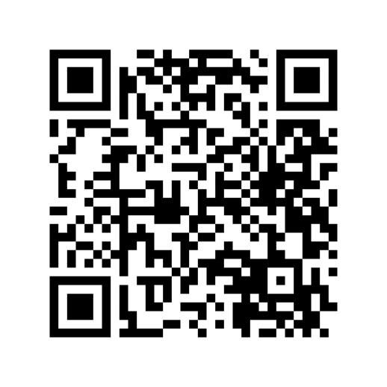

Robert Scott
Director, Community Reinvestment
COMMUNITY
REINVESTMENT

Slide 11
THANK YOU & QUESTIONS?

